Slide 1
Sign In Canada
June 1, 2020
Michael Goit
Director, Digital Identity
Office of the Chief Information Officer

Slide 2

Today’s GC Cyber Authentication Solution
In operation since 2012, enables clients to sign-in to >100 GC services
Consists of two managed (contracted) services:
GCKey, which is the GC-branded credential
Credential Broker Service, enables login via 16 Canadian banks
Enterprise service is mandatory for online applications offered to the public for which authentication is required
Uses ‘anonymous’ credentials (i.e. not bound to identity)
Once signed in, users enroll with programs individually
Identity process in program space
Each Relying Party maintains own chooser page and integrates with each credential provider separately
Credential count at end of April 2020:
12 million GCKeys
and
8.8 million bank credentials

Slide 3
Evolution: Sign In Canada
Provides a common chooser screen for all GC applications
Improves user experience
Continues to accept current anonymous credentials
Ensures continued access to GC services
Enables acceptance of trusted digital identities
Supports interoperability with other jurisdictions
Enables clients to switch their credential while preserving program enrolment
Uses open technology standards (e.g. OAuth, OIDC)
Enables use of new technology (e.g. digital wallets, verifiable credentials)

Slide 4
Sign In Canada - MVP
With TDIC and GC EARB endorsement, initiated in-house build of Minimal Viable Product (MVP) and successfully demonstrated:
Common sign in with customizable list of credential and Level of Assurance
New design for chooser screen with feedback from, ATIP, Digital Transformation Office, and user testing with IRCC clients
Integration with:
GCKey and banking credentials,
Social logins (Microsoft, Google)
Provincial Digital IDs (Alberta and BC)
‘Translation’ of new protocols (e.g. OIDC) to existing (i.e. SAML) meaning RPs can leverage new credentials without change to existing applications.
Ability for user to switch to a different credential and maintain program enrolment
Notes:
Sign In Canada in-house build initiated May 2019 - as per direction from this committee (TDIC) and endorsement from GC EARB.
Used same business requirements contributed by departments and agencies for the RFP process.
Progress: Developed and built core Sign In Canada platform with common chooser screen
The new user interface includes customizable credential choices and content – according to requirements of the RP (e.g. CRA users would be given the choice of CRA Login or banks, but not GCKey)
Integrated existing GCKey, CBS banking credentials
Integrated social media credentials (Google, Microsoft) and and My Alberta Digital ID and BC Services Card digital ID.
Demonstrated transition of departments and agencies (Relying Party) from current Cyber Authentication services to Sign In Canada with no impact to users (no re-enrolment required)
Implemented a switch credential capability for any credential (today can only switch banks)
Implemented capability for Identity attributes to be passed directly to the program outside the Sign In Canada platform (privacy)
Integrated ATIP, TC, FedDevON and others in Test Enviro
Established a Legal working group to confirm authorities required to operate

Slide 5
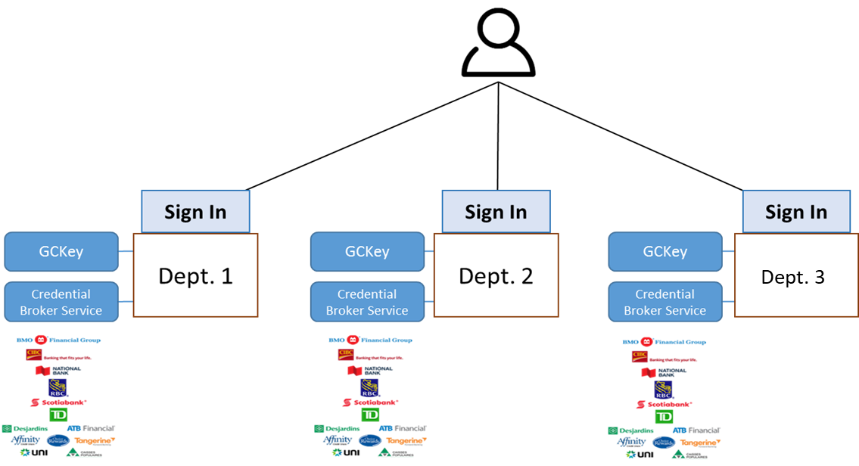
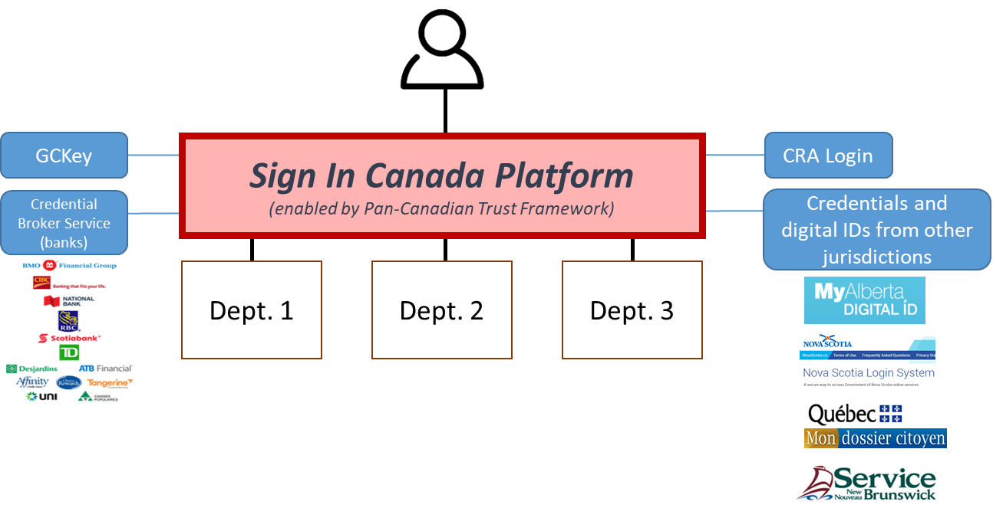
High-level Architecture
Current State
Future State
(endorsed by GC EARB March 2018)
Users can sign in with a GCKey, banking username/password or CRA Login
Each department/agency must maintain its own sign in page (duplication of effort)
Inconsistent user experience
Digital identities would need to be added department-by-department
Security concerns with legacy technology
Expanded selection of sign in choices (including existing & new credentials)
Single integration point for departments and agencies
Common sign in page for consistent user experience
Ability to accept trusted digital identities from other jurisdictions
Updated security & privacy features
Notes:
ALIGNED WITH ONEGC VISION
Duplicative - each department/agency maintains its own sign in page
Inconsistent user experience
Piecemeal - Digital identities would need to be added department-by-department (currently ESDC connected directly to MADI and CRA connected directly to BC)
Security concerns with legacy technology
Integrates departments and agencies, which reduces costs and infrastructure complexity
Focuses departments and agencies on their core commitments by allowing them to delegate much or all of their identity-proofing requirements
Provides a consistent user experience via Common sign in page
Accepts trusted digital identities from other jurisdictions
Updates, regularizes, and globally distributes security & privacy enhancements
Enhances economic productivity -decreases time and steps needed to complete common tasks

Slide 6
Sign In Canada MVP approach
Lean team
Working in open
Github repository
Investment in automation
DevOps pipeline
Iterative design with user testing

Slide 7
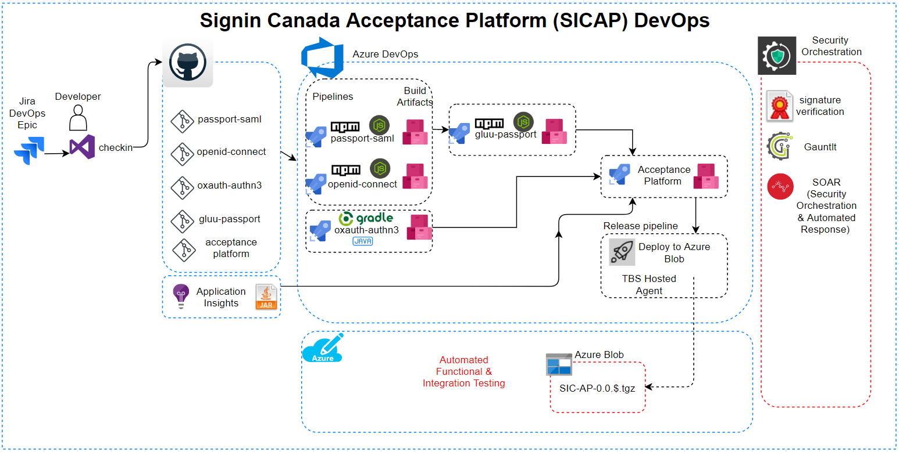
DevOps Pipeline Diagram

Slide 8
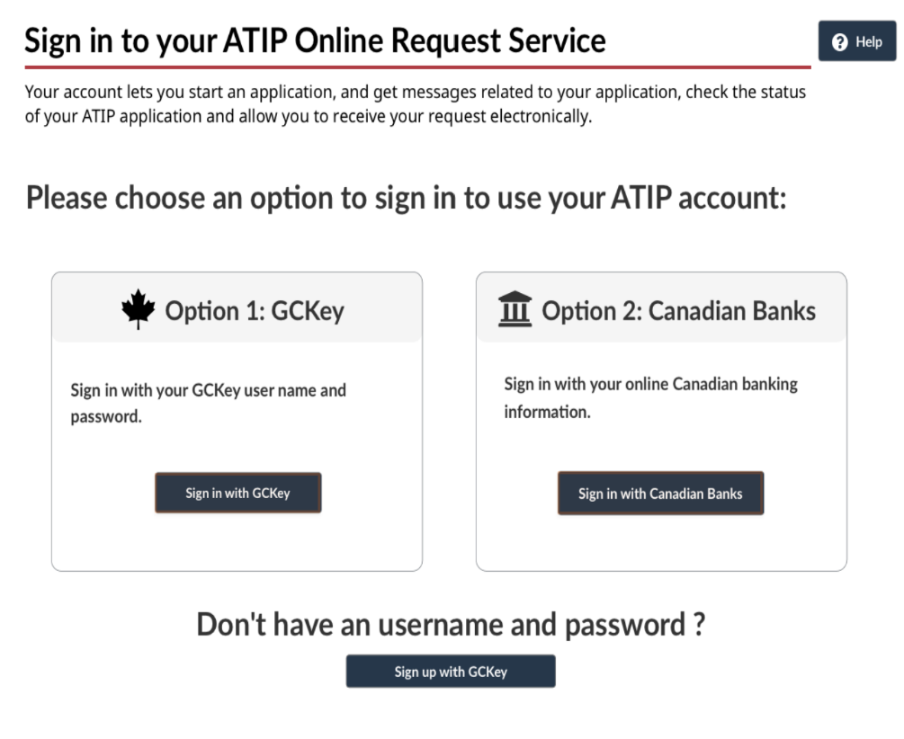
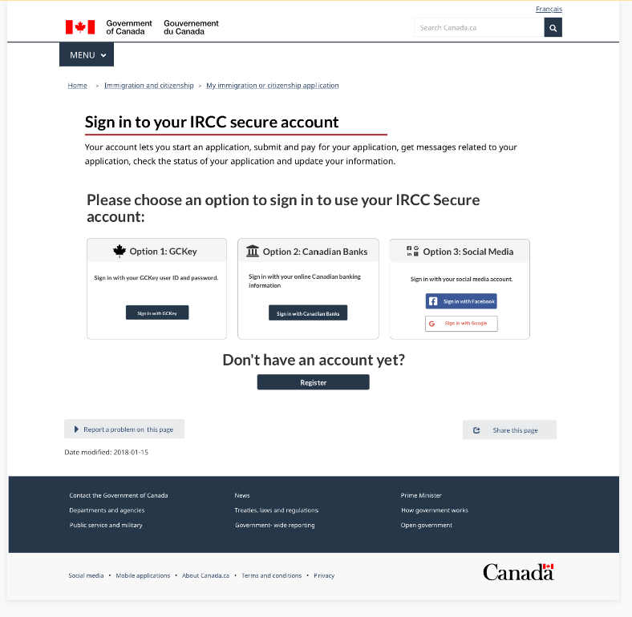
Iterative Design
Evolution of chooser screen design from original concept based on today’s solution with feedback from ISED, ATIP, OneGC group, Digital Transformation Office, and user testing with IRCC clients.
Prototyping included creating ‘clickables’ using tools such as Sketch Cloud, InVision, etc.

Slide 9
Sign In Canada
Sign In Canada
MVP Demo

Slide 10
Discussion
Sign In Canada
Discussion and Q & A

